Slide 1

Basics of Docker
- Avinash

Slide 2
Acknowledgement
Content of these slides is adapted from various sources on the Internet (References in the end)
Notes:
Add screenshots of results of docker run, logs, etc. commands

Slide 3
Agenda
Introduction
What is Docker and why is it used?
Docker versus Virtual Machines
Install Docker
Docker Images vs Docker Containers
Docker registry
Running Docker images
Port Binding – Binding container port to local machine port
Start and stop containers
Private Docker Registries
Dockerfile – Create own/ custom Docker images using Dockerfile
Overall development and deployment flow using Docker

Slide 4
What is Docker?
Docker is a virtualization software
Makes development and deployment of software easier
It does this by packaging an application with all the necessary dependencies (libraries), configuration files, system tools into one standardized unit
This standardized unit is called an Image (running instance -Container)
A container is a portable artifact, which can be easily shared or “distributed” or “deployed”
With Docker, you get a single entity that can reliably run anywhere
Notes:
Web hosting allows individuals and businesses to make their websites accessible worldwide through the Internet (WWW). A business or individual must have their own computer or server for web hosting, however, under Cloud Hosting, websites are hosted on multiple interconnected web servers. These server resources are provided by cloud based hosting companies – like AWS, for example.
Cloud services are application and infrastructure resources that exist on the Internet. Third-party providers contract with subscribers for these services, allowing customers to leverage powerful computing resources without having to purchase or maintain hardware and software.
Virtualization relies on software to simulate hardware functionality and create a virtual computer system. This enables IT organizations to run more than one virtual system – and multiple operating systems and applications – on a single server. The resulting benefits include economies of scale and greater efficiency.

Slide 5
The Docker Platform
“Docker provides the ability to package and run an application in a loosely isolated environment called a container. The isolation and security allows you to run many containers simultaneously on a given host. Containers are lightweight and contain everything needed to run the application, so you do not need to rely on what is currently installed on the host. You can easily share containers while you work, and be sure that everyone you share with gets the same container that works in the same way.” – Docker overview

Slide 6
How were applications developed and deployed before Docker?
Each developer needed to install and configure all services (Database, Server instance, etc.) directly on their OS on their local machine
Example: To run a JS application, you need the JS code, the package.json file, along with Node.js (JavaScript runtime and library) and npm (package manager for JavaScript)
Depending on which OS a developer is using, the installation process will be different for each developer (or Server side teams)
Multiple installation steps for each service
Suppose an application uses 10 services, each developer has to install 10 services on their machine (times number of developer)

Slide 7
How are things different with Docker?
Developer (or server side team) does not have to go and look for binaries corresponding to each service to be installed
Instead, you have images – each image / container is its own isolated environment (example: node.js, npm, init files are all in one container)
You also have images / containers corresponding to services (if need be)
Use a simple Docker command to start service as a Docker container
$docker run postgres (postgres is an image corresponding to postgres service)
Same command (to fetch services) across OS
Standardizes process of running any service on any local dev environment
Easy to run different versions of same service (or app) without any conflicts

Slide 8
Deployment before containers
Development team gives application (say a JS file) and set of instructions to install app to the operations team (at server)
Dev team also hands (or asks to download from the Internet) service software and set of instructions for each software (services) to operations team at server
Installation and configuration is done directly on the server OS
Dependency version conflicts – Two applications dependent on same library but with different versions (but OS can have only one version)
Miscommunication – Developer forgets mentioning some step / additional details / exceptions while communicating steps to install

Slide 9
Deployment with containers
Now, everything is packaged inside the Docker artifact, called image (a running instance of which is a container)
No configuration needed on the server
The operation team now only needs to run the Docker command that fetches the container package (Image) created by the Dev team
Only thing needed at Server – Docker runtime should be installed on server
Any additional software required is also fetched as a Docker image (from public repository)

Slide 10
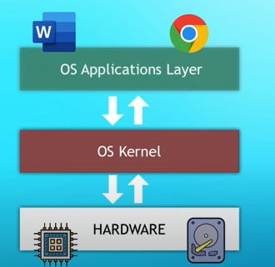
Docker versus Virtual Machine
But first, what are OS layers?
Every OS primarily has two layers
Application layer
Kernel layer
Applications reside in application layer
Kernel is middleware

Slide 11
Docker versus Virtual Machine
Both are virtualization software but differ on what part of the OS they virtualize
Docker virtualizes the OS Application layer
The Docker container therefore consists of the OS Application layer and some other services and apps that run on top of the OS application layer
Uses the kernel of the host that is running Docker
The Virtual Machine on the other hand virtualizes both the OS application layer and the kernel, in other words, it virtualizes the entire operating system

Slide 12
Docker versus Virtual Machine
Consequently, Docker images are much smaller than Virtual Machine images (since it only implements OS Application Layer) – couple of MB versus couple of GB
Speed – a few seconds to start up versus minutes to start up
Compatibility – Docker is only compatible with Linux distros whereas VM can run any virtual OS on any host OS (however Docker can run on any OS as long as the host OS has hypervisor enabled)
Also – note that most Docker containers are Linux based (Docker was originally built for Linux – host OS should be Linux)
Docker Desktop – allows running Linux containers on Windows or MacOS (using Hypervisor or WSL2)

Slide 13
Install Docker
Go to the official Docker website
Follow installation steps
Linux
Ubuntu
Windows
MacOS
Docker Desktop consists of
Docker Engine
A server running Docker daemon; manages images and containers
Docker CLI – Client
CLI to interact with Docker server; execute Docker commands to stop/start/ containers
GUI Client

Slide 14
Docker images and containers
Docker images (To view images: $docker images)
An executable application artifact
Includes app source code, and complete environment configuration
OS application layer, and other dependent libraries/ services
Example: JS application + Java runtime + node.js + npm + initialization files
Docker containers (To view containers: $docker ps)
A running instance of a Docker image
Starts an application
Can run multiple containers from same image (e.g. when you need to run multiple instances of same application for increased performance)

Slide 15
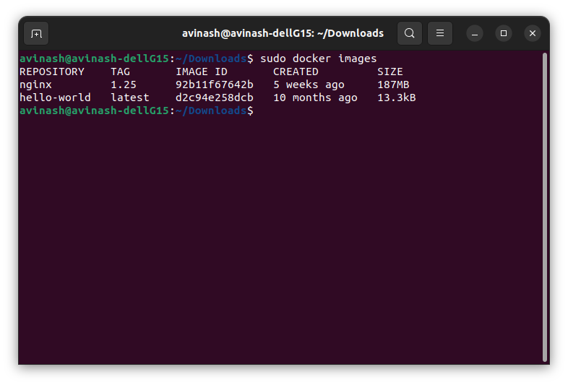
Docker images

Slide 16
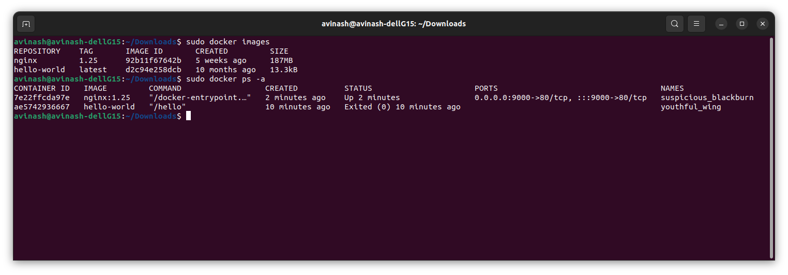
Docker containers

Slide 17
Docker Registry
How do we get Docker images?
Docker Registry
A storage and distribution system for Docker images
Official images available from applications like Nginx, Postgres, etc.
Official images made by Software authors or Docker community
Docker hosts one of the biggest Docker registries, called Docker Hub
Docker Hub
Don’t have to register or sign up to find official images
A dedicated team responsible for reviewing and publishing all content
Image versioning = each version is called a tag
‘latest’ tag generally refers to the newest release (default downloaded tag)

Slide 18
Run Docker images
Step 1: Download (or “pull”) an image
Example: Lets pull an nginx image
Nginx is a web server that has a UI
Using nginx helps access container from a browser and in that way, we can verify that our container has started successfully
Select the tag which you need to pull (best practice: specify tag needed)
$docker pull nginx:1.25 ($docker pull <name>:<tag>)
After this command, Docker client contacts Docker Hub requesting the specified image (Note: we did not specify Docker Hub as registry)
Docker Hub is the default registry where Docker looks for images
Verify downloaded image using $docker images
If tag was not specified, the default latest tag is pulled

Slide 19
Run Docker images
Step 2: Running an image
Example: Continuing with the nginx example
$docker run nginx:1.25 ($docker run <Imagename>:<tag>)
This command creates a container from the given image and starts it
Once the command is run, logs show the running of the container
Now, open a new terminal and run $docker ps
The details of the running container are shown
Note: Docker generates a random name for the container if not specified
Note: By default, terminal is blocked when run command is executed. To prevent this, use flag –d. $docker run –d nginx:1.25. –d stands for detach and it runs container in background and prints container ID
Note: In this case, use $docker logs <containerID>/<containerName> to view logs
Note: In case image is not present locally, Docker automatically pulls image and runs it ($docker run nginx:1.22-alpine)

Slide 20
Port Binding
The next question is how do we access this container?
Right now we can’t because the container is running in the closed Docker network
So we need to expose the container to the host (the local machine that is running the container)
We need to do something called Port Binding
Port Binding: Bind the container’s port to the host’s port to make the service available to the outside world
But what are these ports?
The application inside the container runs on a specific port (or more accurately, is accessible at the port)
Ports are akin to interfaces or access points

Slide 21
Port Binding
If you noticed the details of nginx, you will see that it was running on port 80 of the container
But when you try to access this port, “localhost:80”, you realise that you are not able to access it
Solution: We can tell Docker to bind (or publish) the container’s port 80 to some specific port on the host
This can be done using an additional flag while creating a Docker container
$docker run –d –p 9000:80 nginx:1.25 (-p is publish flag and publishes container’s port to the host) Syntax: -p <host port>:<container port>
Note: Only one service can run on a specific port of the host machine
Goto localhost:9000, and you can access nginx, verify the same using $docker logs <containerID>/<containerName>
Standard practice: Bind the container port to the host at the same port number

Slide 22
Docker Port Binding

Slide 23
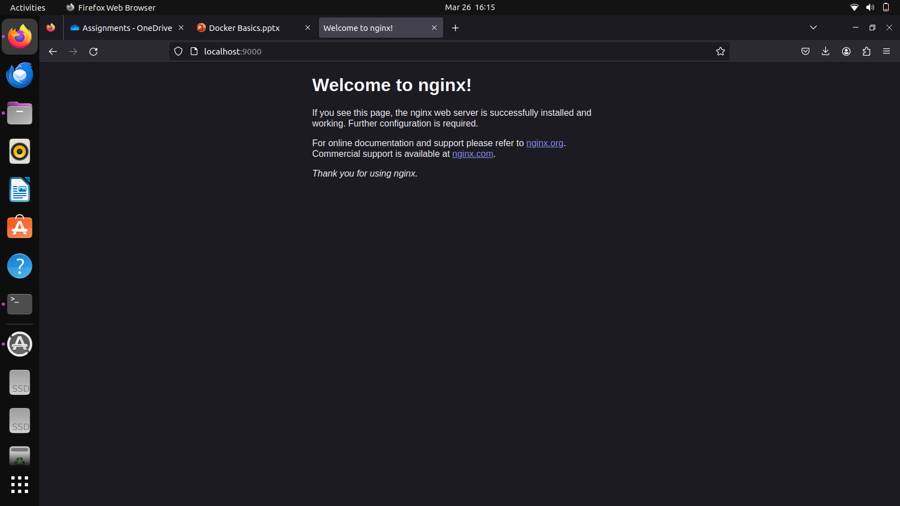
Running the nginx container on localhost

Slide 24
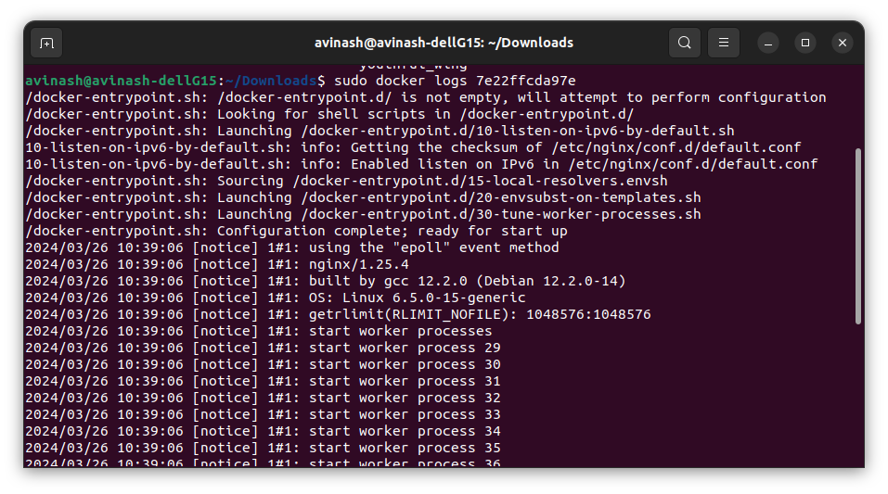
Docker Logs

Slide 25
Start and stop containers
$docker run
Creates a new container every time
Doesn’t re-use the previous container
$docker ps –a: Gives a list of all docker containers on the host (without the –a flag, only the running container is shown)
Instead, you can reuse containers using the start and stop commands
$docker start <containerID(s)>/<containerName(s)>
$docker stop <containerID(s)>/<containerName(s)>
Note: Instead of auto assigned names, you can give your own names to containers while creating them
$docker run –name web-app –d –p 9000:80 nginx:1.23. Syntax: -name <container-name>

Slide 26
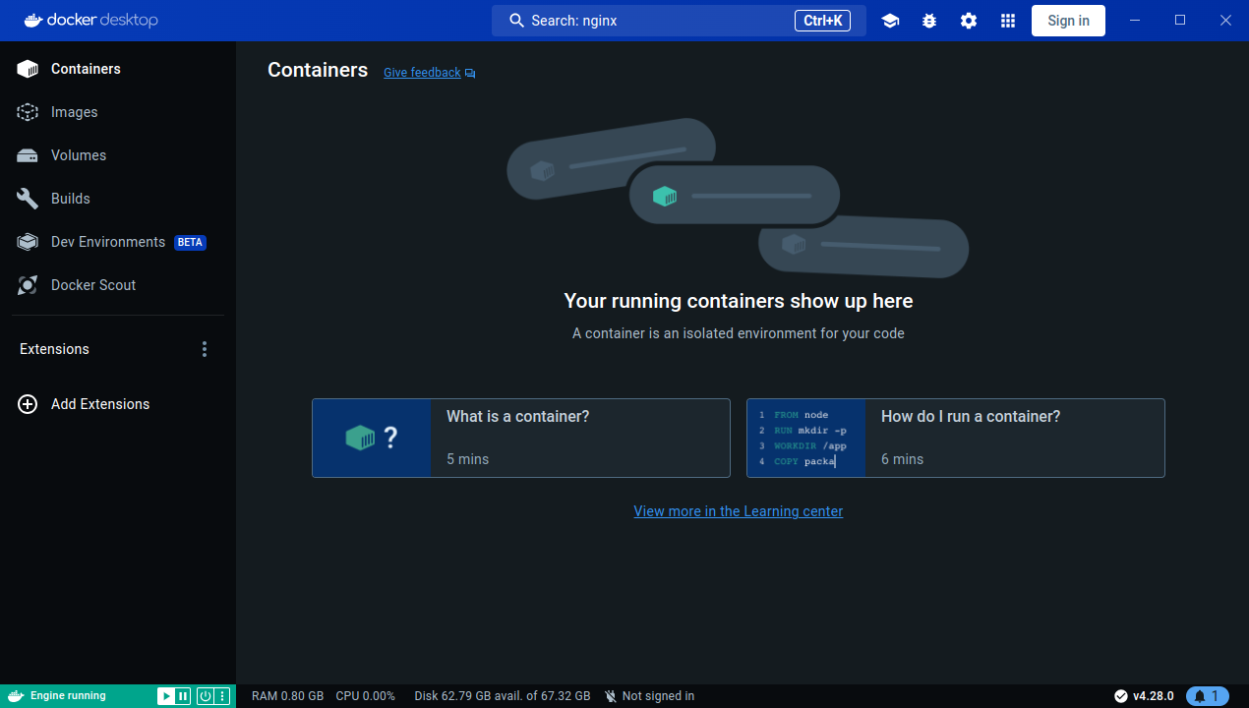
Docker Desktop

Slide 27
Public and private Docker registries
Public
Docker Hub
Largest public registry
Anyone can search and download Docker images
Private
Companies create their own images of their own applications
Need to authenticate before accessing the registry
All big cloud providers provide private registries (Amazon ECR, Google Container Registry, etc.)
Even Docker Hub has a private Docker registry (create account on DockerHub, can create your own public or private registry)

Slide 28
Registry versus Repository
Docker registry
A service providing storage for images (applications)
Each application has its own repository
Collection of repositories
Example: Docker Hub
Docker repository
Collection of related images (but different versions) of an application
Example: Different repositories inside Docker Hub

Slide 29
Create own images - Dockerfile
How does one create their own image for their application? But before that
Why do you need your own image? (Use case):
We want to deploy our application to server
We want to deploy our application as a Docker container
How do we take our application code and make it into a Docker Image?
We need to create a “definition” of how to build a Docker image from our application
That “definition” is written in a Dockerfile
Dockerfile – a text document that contains commands to assemble a Docker image
Docker can then build an image by reading those instructions

Slide 30
Dockerfile – Explained via an application
In this part, we will design a simple JavaScript application (a node.js application) which displays a certain hello message
This JavaScript application is to then be deployed as a Docker container
For that, we need to first create (or build) a Docker image corresponding to our application
To build a Docker image, we use a Dockerfile (which consists of steps to build an image from an existing application)
Once the Docker image is built, it is run (Docker container)
The running container is then accessed using the web browser on the localhost (or whichever machine the application container is running)

Slide 31
Sample JavaScript app
src/server.js
JavaScript application file, consists of the code (behavior/ functionality) of your application
Starts application on specified port, presents hello message when accessed
Requires - ‘express’ library that is used to start the JavaScript application
package.json
Used by npm package manager to identify your project and dependencies
Dockerfile
Defines how a Docker image is built from existing application

Slide 32
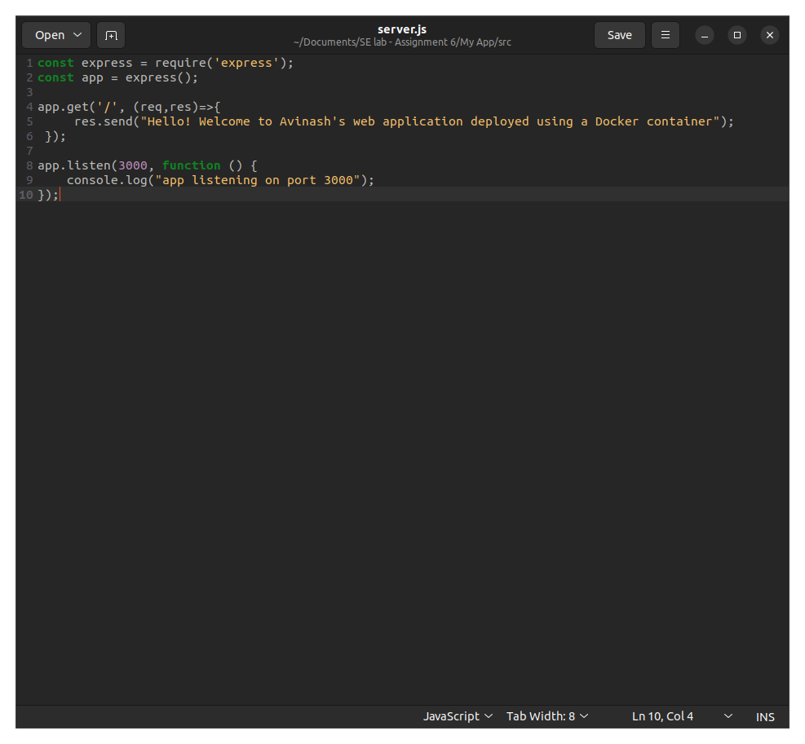
Sample app – server.js

Slide 33
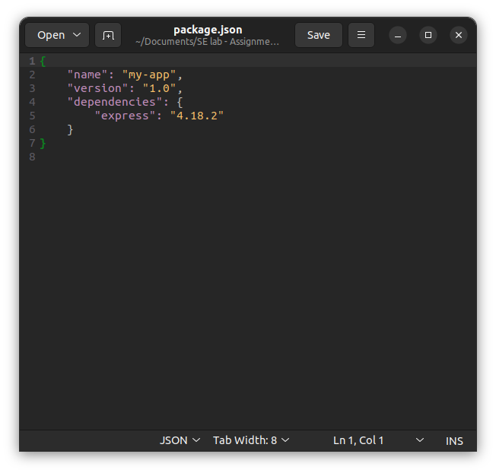
Sample app – package.json

Slide 34
Sample app – Deconstructing Dockerfile
Structure of Dockerfile:
Dockerfile starts with FROM directive where we create a new Docker image from a base image of type ‘node’
If you check Docker Hub, you will see that the ‘node’ is like any other image
This image is based on light weight Linux and consists of node and npm (needed to run JavaScript)
‘Base image’ is a Docker image that your custom image is based on
This has Node.js, npm, etc. whatever tool/ library you need for your application
Can install other libraries inside the image, as needed (just use RUN commands)
Generally, choose base image depending on which tools you need to have available
Base image defined in Dockerfile using a directive called ‘FROM’
Remember, Dockerfile must begin with a FROM instruction
FROM means to build this image from the specified base image

Slide 35
Sample app - Deconstructing Dockerfile
Note:
Most of the Docker images are Linux based, alpine is a light weight Linux operating system
Therefore any Linux command can be written inside the image (and run inside the container)

Slide 36
Sample app – Directives inside the Dockerfile
‘FROM’ command
Build this image from the specified image (node:19-alpine)
‘RUN’ command
Will execute any command in a shell inside the container environment
Example: RUN npm install - will download dependencies inside the container and install them (the dependencies are listed in package.json)
Container – its own isolated environment and has Linux OS, ‘Node.js’ and ‘npm’ installed. However we are executing ‘npm install’ to install dependencies
We need package.json because that is what ‘npm’ command reads to install dependencies

Slide 37
Sample app – Directives inside the Dockerfile
Next, we need to copy application files from the host system onto the container
COPY directive:
Can copy individual files like ‘package.json’ into the container
COPY package.json /app/ (copy a single file into folder /app inside container)
COPY <src – local computer> <space> <dest – inside container>
Can also copy directories directly inside container
COPY src /app/
/ at the end is important – tells Docker to create folder if does not exist

Slide 38
Sample app – Directives inside the Dockerfile
Next, we need to change to /app/ directory in container before we run the application
WORKDIR directive
Equivalent of ‘cd’
Sets the working directory for all following commands
WORKDIR /app
The final step is to run the command node to run server.js. Usually RUN directive is used but if the command is the last command in the Dockerfile, we use the directive CMD instead
CMD

Slide 39
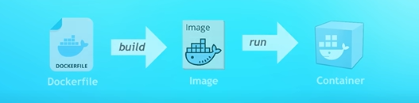
Sample app – Directives inside the Dockerfile
CMD directive
The instruction that is to be executed when a Docker container starts
The last RUN command in Dockerfile is the CMD command
There can be only one ‘CMD’ instruction in a Dockerfile
CMD [“node”, “server.js”] (CMD [“<command>”,”<parameter>”]

Slide 40
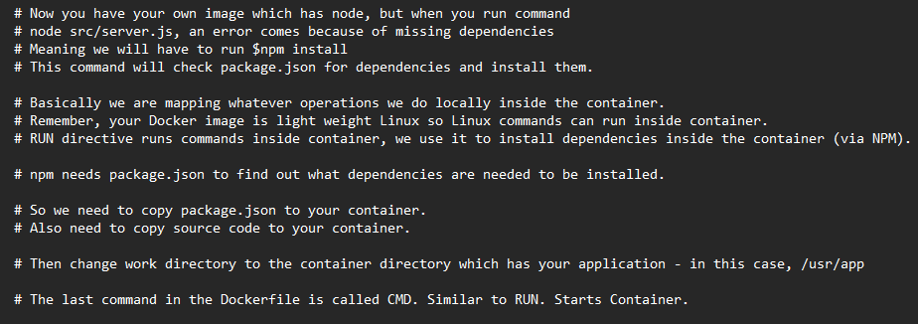
Sample app – my code comments in Dockerfile (read for better understanding)

Slide 41
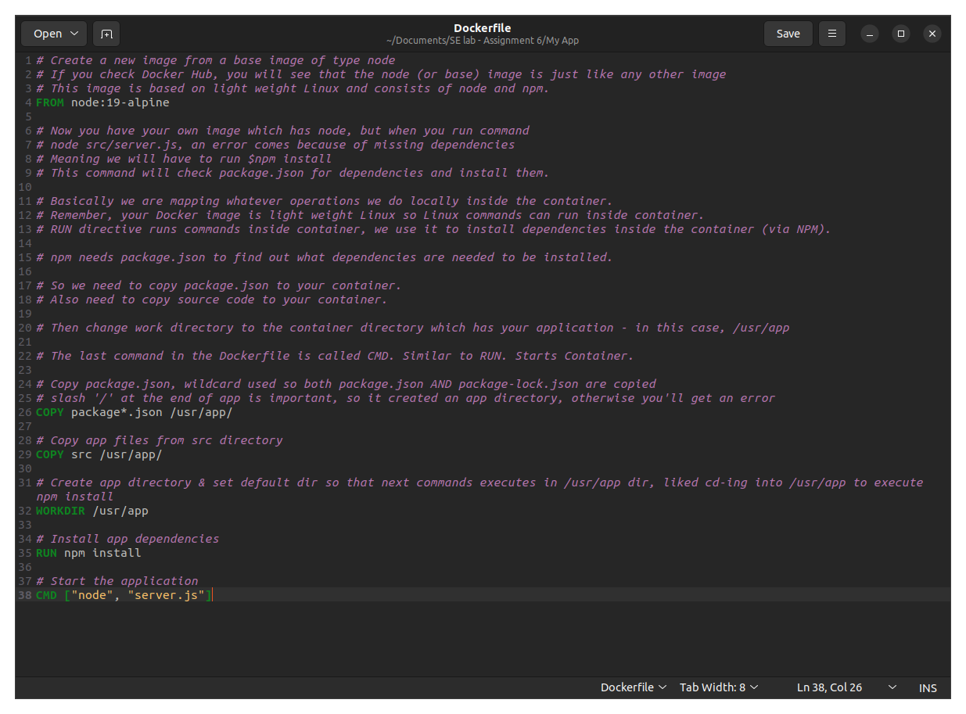
Sample app - Dockerfile

Slide 42
Build Docker image (following your Dockerfile)
Now that we have definition in Dockerfile, we go ahead and build the Docker image from it (Note: I ran these commands in VS terminal)
These commands should be run in the directory which has Dockerfile
$sudo docker build –t node-app:1.0 . (Note: The . refers to current directory)
$sudo docker build –t <image name>:<tag name> <location of image>
Remember, Docker images consists of layers
Each instruction in the Dockerfile creates one layer
These layers are stacked and each one is a delta of the changes from the previous layer
See the logs and you can see the instructions in your Dockerfile executed
Check your image using $sudo docker images
Create and run container using $sudo docker run –d –p 3000:3000 node-app:1.0
Check your running container using $sudo docker ps and localhost:3000 and logs

Slide 43
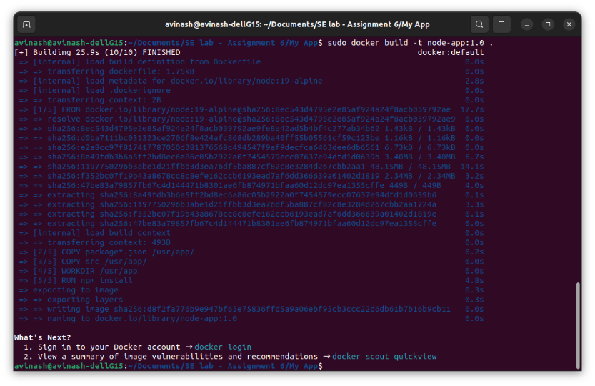
Building Docker image

Slide 44
The main steps to 'Dockerize' your application
Have your application ready (the one which needs to run in a Docker container)
Write Dockerfile
Build Docker Image
Run as Docker container
Note: Can use Docker GUI client to check your images and containers, which are currently running, stopped. You can start and stop containers and do some other tasks in GUI window

Slide 45
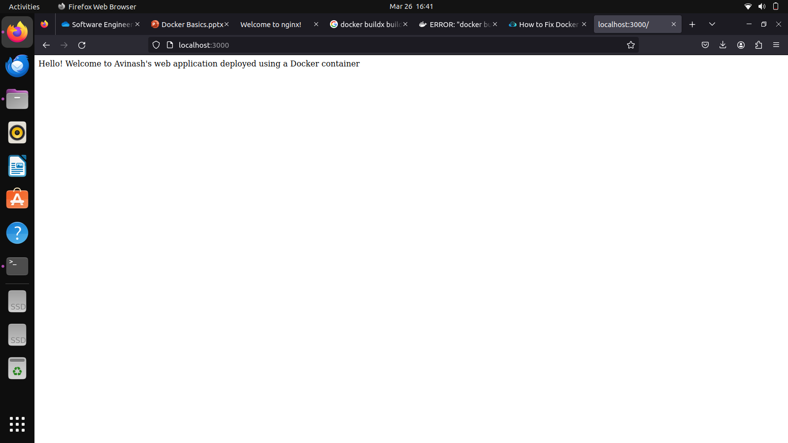
Running custom JS app in Docker container

Slide 46
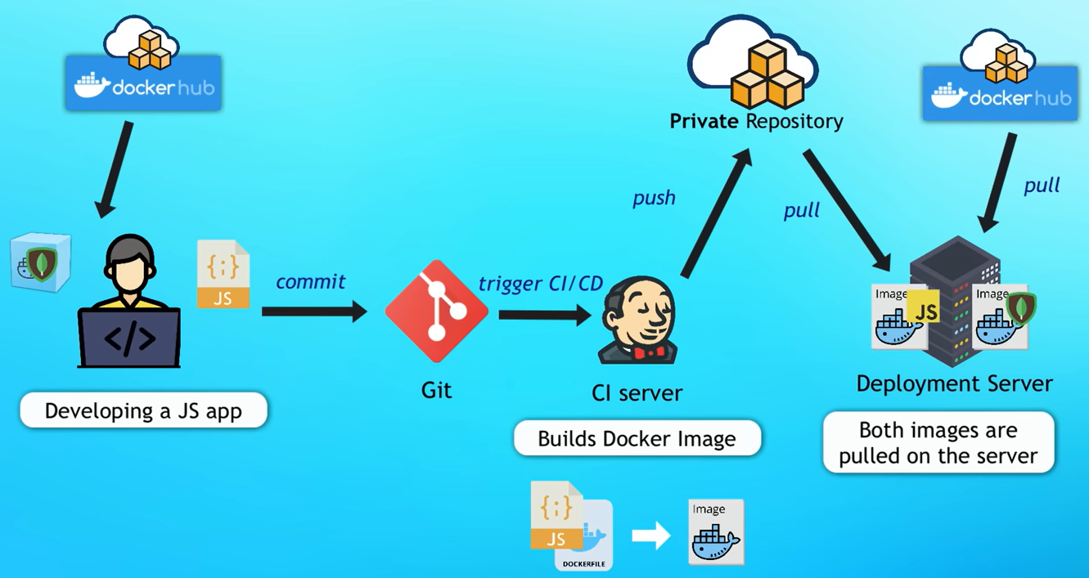
Where Docker fits in the complete development and deployment process

Slide 47
Docker Assignment – Tasks and marks breakup
Install Docker – 1 M
Pull ‘nginx’ from Docker Hub – 1 M
Run a Docker container (instantiate the previously downloaded image) in detach mode, name the container <name>_<rollnumber> – 1 M
Check details of the running Docker container, specifically its port number, then bind the container port number to local machine's port number. Then access the container via the bound port number through your web browser – 1 M
Create a custom Docker image for your own web application – 6 M
Output: This application should display "Hello, welcome to <your name> (<roll number>)'s web application!“ when accessed
Build this image by first making a simple javascript app, then write your own Dockerfile. Build the image using Dockerfile, run Docker image as a Docker container on your local system – 4 M
Your web application should be accessible on port 7xxx of localhost. Therefore, bind the port of the container to your local system – 2 M (where xxx is your roll number)

Slide 48
Docker Assignment – Submission
Deadline: April 8th (AI), April 12th (CS/ CM)
Submission format:
Will be announced in class
Most likely: A zipped file containing the following
Screenshot of list of containers on your local machine
Screenshot of the nginx web server Docker container (accessible on the browser as localhost:<yourchosenportnumber>)
Screenshot will be of your custom JavaScript application that is deployed on your local system in a Docker container (accessible on the browser as localhost:<yourchosenportnumber>)
Folder containing your JavaScript application code and Dockerfile (that creates a Docker image out of this JavaScript code)
Hint: You can use the following code for reference – source code

Slide 49
References
https://www.vmware.com/in/solutions/virtualization.html
https://docs.docker.com/get-started/overview/
https://aws.amazon.com/docker/
https://www.youtube.com/@TechWorldwithNana
https://gitlab.com/nanuchi/docker-in-1-hour
https://www.youtube.com/watch?v=1ERdeg8Sfv4
https://azure.microsoft.com/en-in/resources/cloud-computing-dictionary/kubernetes-vs-docker/
https://www.youtube.com/watch?v=a1M_thDTqmU

Slide 50
Thank you!

